Slide 1
ESD Presentation
Jeevaraam K (2020H1400216H)
Rishi S Phaye (2020H1400230H)
M.E. EMBEDDED SYSTEM

Slide 2
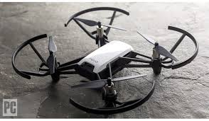
AUTO DRONE

Slide 3
Contents
Abstract
Aim and Objectives
Proposed Methodology
Block Diagram
Architecture Overview
List of Subsystems
Individual Subsystems
Currently Implemented Subsystems
Results and Output
Conclusion
Extensive Information

Slide 4
Abstract
Aimed at designing a common architecture in terms of hardware and software for an automated drone.
Divided into two parts, a Main Controller and the subsystem layer.
For every feature (or) operation, a separate subsystem is designed and attached with the main controller.
Main controller receives all the inputs from various subsystems and makes driving decision based on those inputs.
All the above said subsystems are attached to the main controller through a communication bus based on I2C.

Slide 5
Aim and Objectives
Aim
To design a drone that can travel on its own from one place to another.
Objectives
To design a common architecture for autonomous drone
To implement an Autonomous driving sub-system corresponding to above architecture
To implement Main Controller program corresponding to above architecture
To interface the Subsystems with Main Controller using Interface Protocol

Slide 6
Proposed Methodology
Inspired by Electronic Subsystems in automobiles
Basic Architecture is designed to maintain interoperability with various devices and keep the design open-ended
Every work is carried out by individual sub-systems to ensure distributed workloads and also isolate failures to a specific sub-system
Main Controller collects the parameters from different sub-systems and takes decision based on the collected data
Output is produced that mimics an RC Controller so that existing drones can be easily retro-fitted

Slide 7
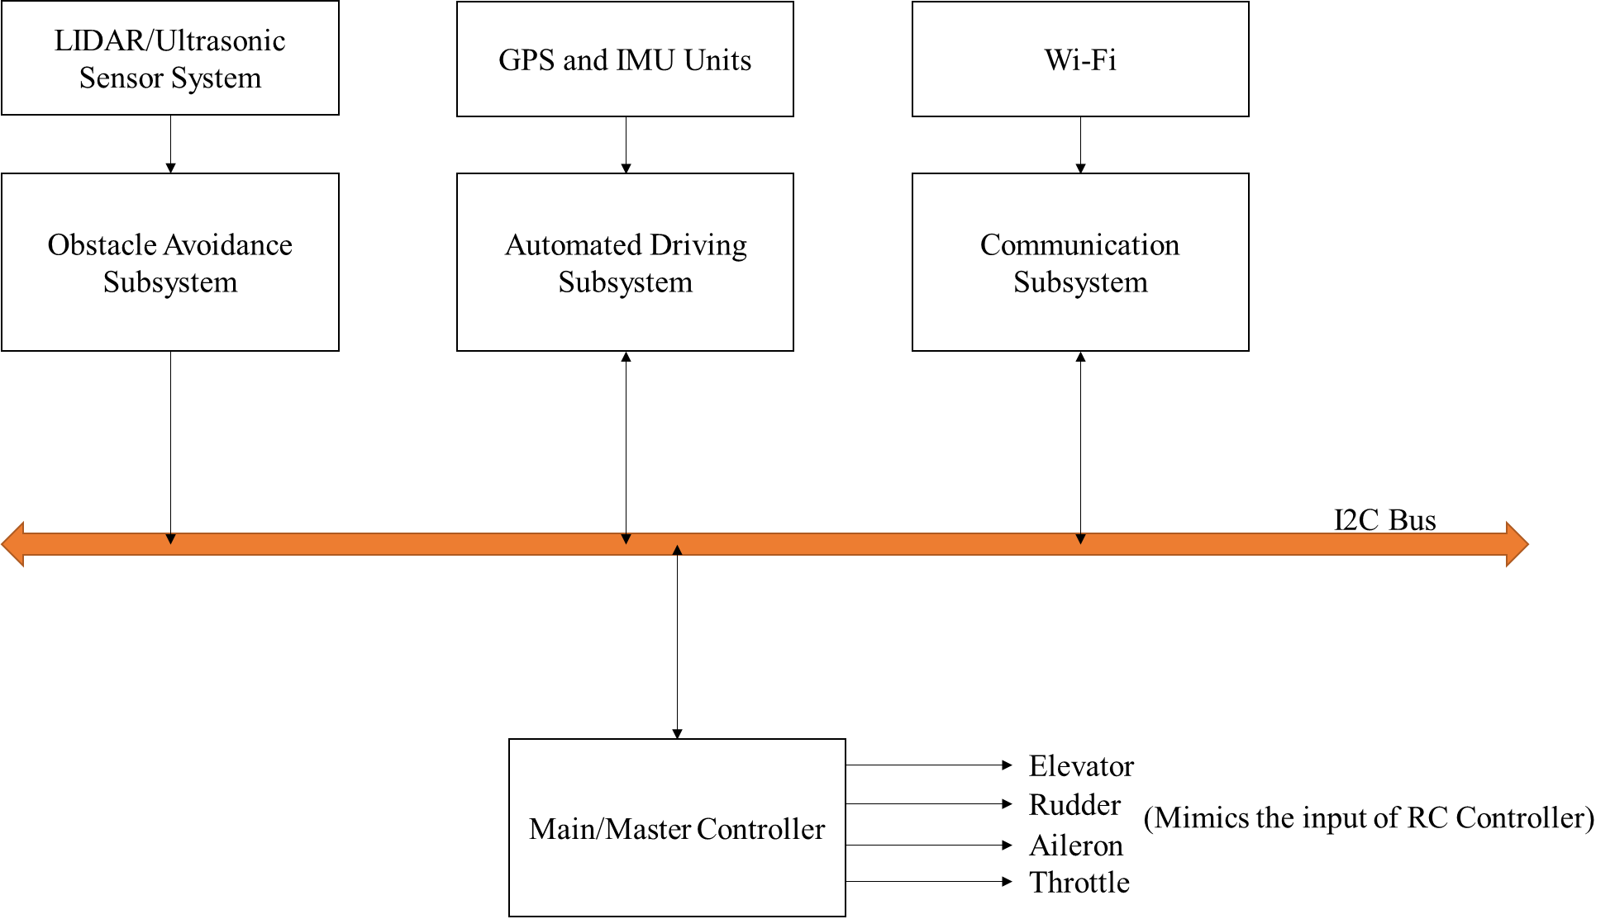
Block Diagram
Fig 1. Overall Block Diagram of Proposed System

Slide 8
Architecture Overview
The project aims to design an architecture where a master controller receives data from all the attached sub-systems
In the initial stages, three subsystems are planned.
An autonomous driving sub-system
A communication sub-system
An obstacle avoidance sub-system.

Slide 9
Architecture Overview
Communication sub-system aimed at providing communication between the drone and the user
Autonomous driving subsystem contains two input sensors, a GPS receiver and an IMU unit.
Obstacle avoidance sub-systems constantly looks for any obstacles it gets in its way.
All the above data is collected by the Main Controller through a Communication Bus and corresponding action is taken by the Main Controller

Slide 10
Individual Subsystems

Slide 11
Subsystem Address Ranges Definition
Start Address | End Address | Type of Subsystem
0x10 | 0x19 | Relative Position Subsystem
0x20 | 0x25 | GPS Subsystem
0x26 | 0x29 | External RF Communication Subsystem
0x30 | 0x39 | Obstacle Avoidance Subsystem
0x40 | 0x49 | Health Monitoring Subsystem
0x50 | 0x59 | Communication Subsystem

Slide 12
GPS Subsystem Register Structure
Register Address | Data Type and Length | Description
0x01 | 1 – U Int | No of Satellites Connected
0x02 | 4 – Float | Latitude
0x03 | 4 – Float | Longitude
0x04 | 4 – Float | Altitude
0x05 | 4 – Float | Horizontal Accuracy
0x06 | 4 – Float | Vertical Accuracy
0x07 | 4 - Float | Refresh Rate (in ms)

Slide 13
Relative Position Subsystem Register Structure
Register Address | Data Type and Length | Description
0x01 | 1 – U Int | Type of Subsystem
0x02 | 4 – Float | X-Value
0x03 | 4 – Float | Y-Value
0x04 | 4 – Float | Z-Value
0x05 | 4 – Float | Refresh Rate (in ms)

Slide 14
Obstacle Avoidance Subsystem Register Structure
Register Address | Data Type and Length | Description
0x01 | 1 – U Int | Reserved (Type of Subsystem)
0x02 | 4 – Float | Direction of Obstacle (Degrees)
0x03 | 4 – Float | Distance to Impact (Metres)
0x04 | 4 – Float | Refresh Rate (in ms)

Slide 15
Communication Subsystem Register Structure
Register Address | Data Type and Length | Description
0x01 | 1 – U Int | Type of Communication
0x02 | 4 – Float | Latitude
0x03 | 4 – Float | Longitude
0x04 | 4 – Float | Altitude
0x05 | 1 – U Int | Back to Origin

Slide 16
External RF Communication Register Structure
Register Address | Data Type and Length | Description
0x01 | 1 – U Int | Type of RF
0x02 | 2 – U Int | Channel 1
0x03 | 2 – U Int | Channel 2
0x04 | 2 – U Int | Channel 3
0x05 | 2 – U Int | Channel 4
0x06 | 2 – U Int | Channel 5
0x07 | 2 – U Int | Channel 6

Slide 17
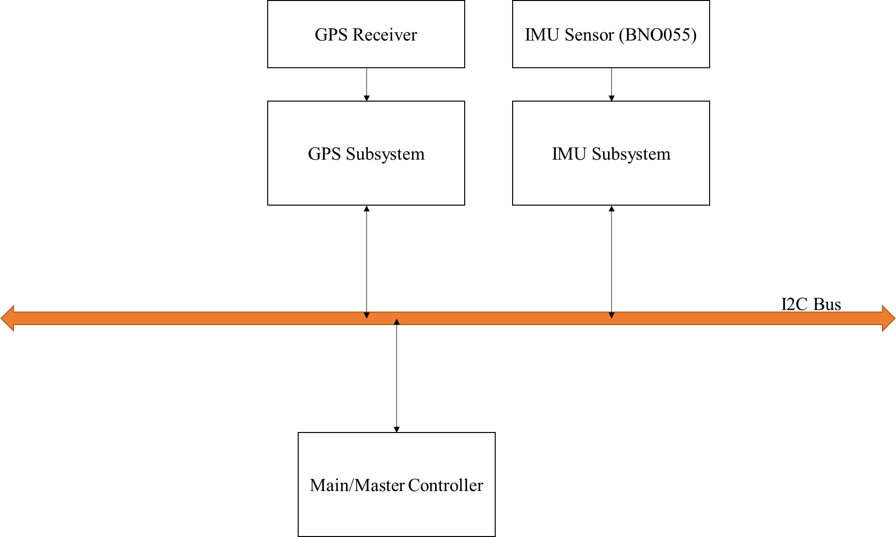
Currently Implemented Subsystem
Fig 2. Block Diagram of Currently implemented System

Slide 18
Current Status
Main Controller – MSP432P401R
Absolute Position Subsystem – Arduino Due (Static GPS Position due to non-availability of GPS Module)
Relative Position Subsystem – Arduino Due with BNO055 (Sensor was malfunctioning due to age. Hence static values were given)
Communication between different Sub-systems is implemented in code

Slide 19
Results and Output
Currently, the architecture design is completed with major sub-systems. Some of the sub-systems design is completed.
GPS Subsystem library is created to attach with generic GPS module
Relative Position Subsystem library is created to attach with BNO055 sensor
All the Codes and Documentation is checked-in at GitHub repo.
Repo : jeevaraam/AutoDrone (github.com)

Slide 20
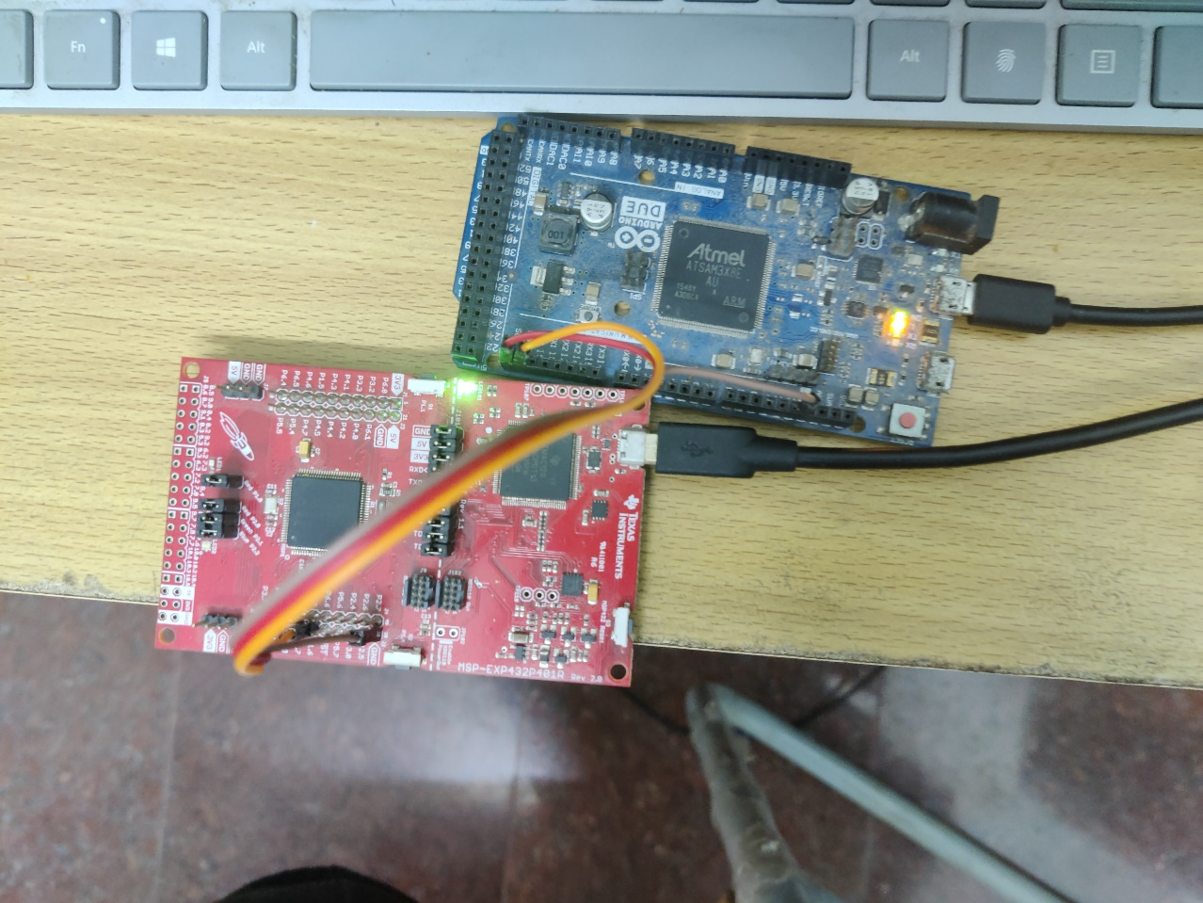
Results and Output
Fig 3. Verification of I2C Communication between two Subsystems

Slide 21
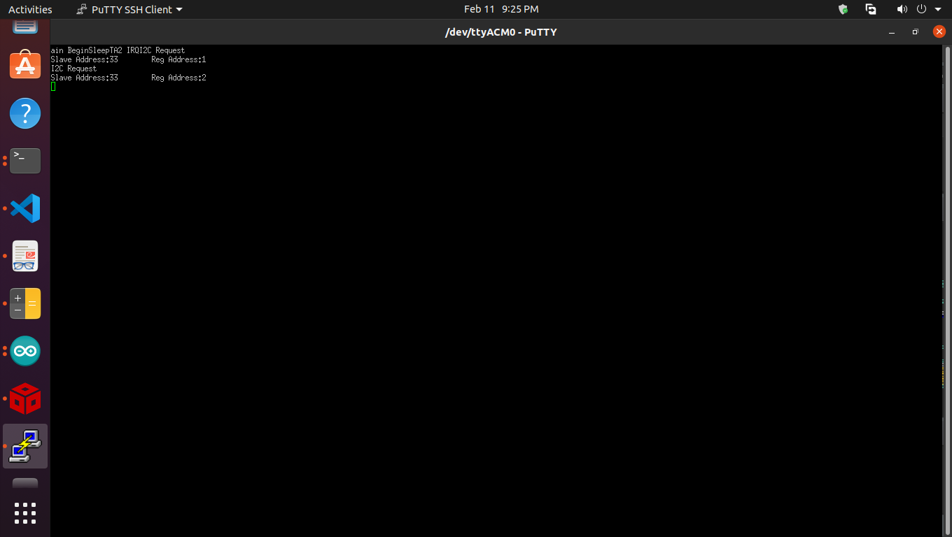
Results and Output
Fig 4. MSP432 Debug Print of I2C Data Collection Routine

Slide 22
Conclusion
The basic architecture for Autonomous Drone was designed and certain parts are kept as open ended to allow modifications and upgradations in future
The Code for Absolute Position Subsystem was created using Arduino and GPS
The Code for Main Controller was created with target microcontroller as MSP432

Slide 23
Pending Works
The GPS interface with Microcontroller was not completed due to non-availability of GPS module
The Relative Position Subsystem was not interfaced with BNO055 due to hardware non-availability

Slide 24
Future Scope
In this architecture, additional features can also be added since the communication bus is I2C and the master controller can be configured after adding the additional subsystems to the bus and integrated with the system easily.
At the end, the Master controller combines all the inputs from multiple subsystems and takes decision based on its configuration input.

Slide 25
EXTENSIVE INFORMATION

Slide 26
Main Controller
Model : MSP432P401R
Programming Platform : Code Composer Studio 10 (Linux)
Clock Configuration
SMCLK : 3 MHz
Core Clock : 48 MHz
UART Speed : 115200 bps
I2C Speed : 430 kHz
Working Modes:
Interrupt based Operational Design to conserve Battery
Timer A2 programmed to wake up MSP432 at 1 second interval
At every wake up, MSP432 collects information from all the slaves and goes to sleep again

Slide 27
GPS Subsystem
Model : Arduino Due
Programming Platform : Arduino IDE
GPS Module : Generic GPS Module with NMEA format output in UART
NMEA Parsing Library : TinyGPS
I2C Slave Address : 0x21
Library created in the name : AutoDroneGPS

Slide 28
IMU Subsystem
Model : Arduino Due
Programming Platform : Arduino IDE
IMU Sensor : BNO055
Sensor Support Library : Adafruit BNO055 Library
I2C Slave Address : 0x11
Library created in the name : AutoDroneIMU

Slide 29
THANK YOU

